Slide 1

IntAct: The molecular interactions database at the EBI

Slide 2
IntAct goals & achievements
Publicly available repository of molecular interactions (mainly PPIs) - >560K binary interaction evidences taken from >13,800 publications (November 2015)
Data is standards-compliant and available via our website, for download at our ftp site or via PSICQUIC www.ebi.ac.uk/intact
ftp://ftp.ebi.ac.uk/pub/databases/intact
www.ebi.ac.uk/Tools/webservices/psicquic/view/main.xhtml
Provide open-access versions of the software to allow installation of local IntAct nodes.
Notes:
(!) needs updating of the stats whenever giving the talk http://www.ebi.ac.uk/intact/statisticView
Goals as set in 2002
How did we address them (in red)

Slide 3

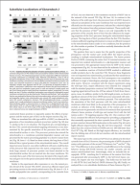
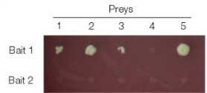
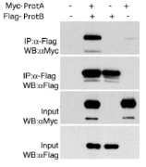




IntAct:
Data storage schema
Entry
[A] Publication level (entry)
Publication
Experiment 1
[B] Experiment level
Experiment 2
[C] Interaction level
Interaction 1
Interaction 2
Interaction 3
Interaction 4
…
…
…
[D] Participant level
Participant 1
Participant 2
[E] Feature level
Features
Features
Notes:
This is a schema of how interaction data is stored in IntAct. Each entry in the database corresponds to a publication [A], that is, a scientific article that is curated by the IntAct team. The information in the paper is analyzed and those experiments that contain molecular interactions are represented in the database (experiment level, [B]). Each experiment corresponds to one or more interactions identified in the same organism using the same techniques. The interactions in each experiment are then listed in the interaction level [C], adding information such as kinetic binding parameters, if they were given by the authors. Each participant is identified using cross-references to existing resources such as UniProt or CheBI, if possible, and represented in the participant level [D]. Finally, features of each participant such as binding sites, tags, mutations affecting the interaction or post-translational modifications can be depicted in detail in the feature level [E].

Slide 4

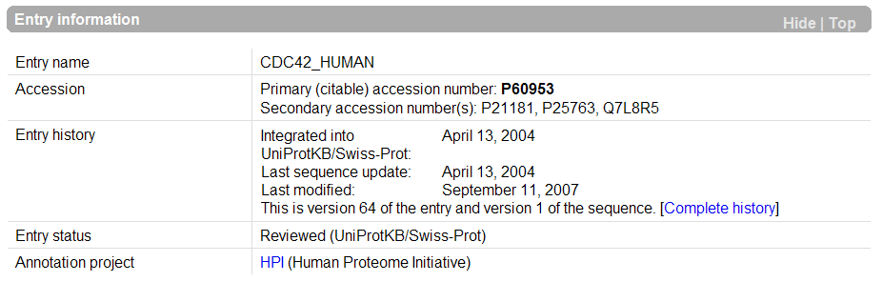
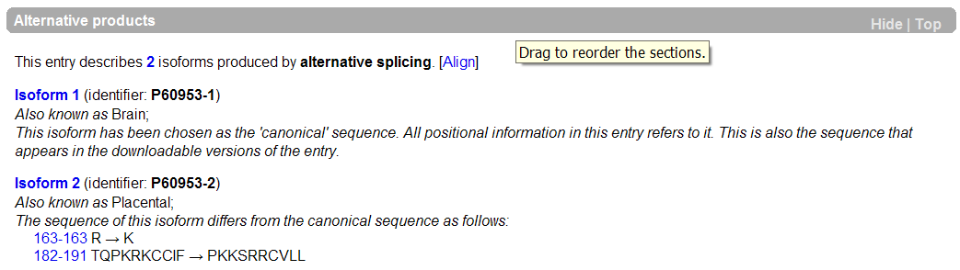
UniProt Knowledge Base
Interactions can be mapped to the canonical sequence…
... to splice variants...
... or to post-processed chains
www.uniprot.org
Notes:
Here we can see:
Primary and secondary ACs
That the entry comes from SwissProt
And 2 splice variants each of which have they own stable identifier and sequence
Note: we annotate down to the splice variant only if it is mentioned in the paper or if we find a sequence match In some cases this allows us to say that one splice variant interact and an other one doesn’t.

Slide 5
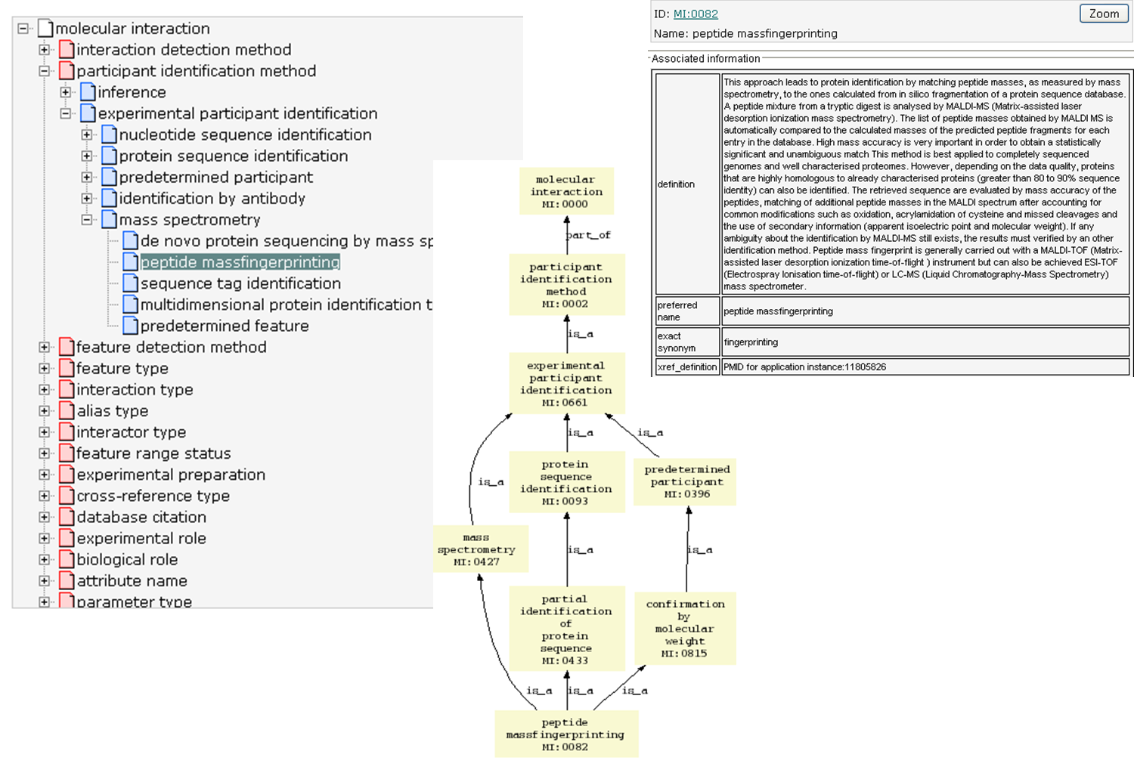
IntAct: PSI-MI ontology

Slide 6


IntAct Curation pipeline
“Lifecycle of an Interaction”
Sanity Checks (nightly)
reject
Public web site
Publication
(full text)
.
exp
annotate
accept
FTP site
p2
I
p1
IMEx
CVs
check
Curation manual
MatrixDB
Mint
DIP
report
report
curator
Super curator
Notes:
6
Tell them that we also export some data for text-miners !

Slide 7













IntAct as a common curation platform
General curation, domain int.
General curation, large scale
UniProt entry related
Extracellular matrix
Model organisms
Immune system
Commercial curation
Cellular mechanics
Regulatory interactions
Specific curation focus/expertise
Host – pathogen interactions
Cardiovascular proteins
Common curation platform
Other DBs
Specific Data Dissemination Platforms

Slide 8
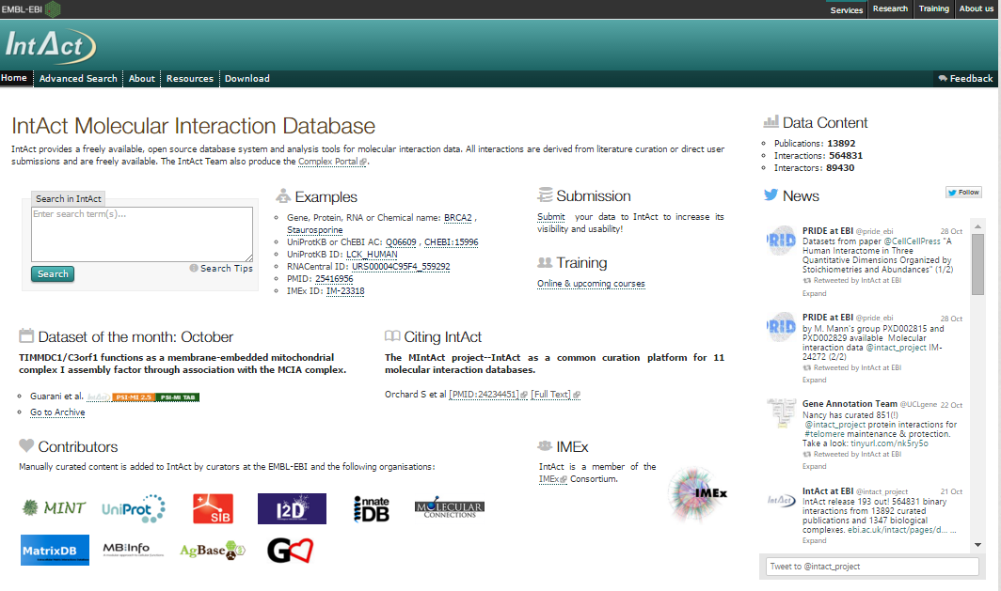
IntAct – Home Page
www.ebi.ac.uk/intact

Slide 9
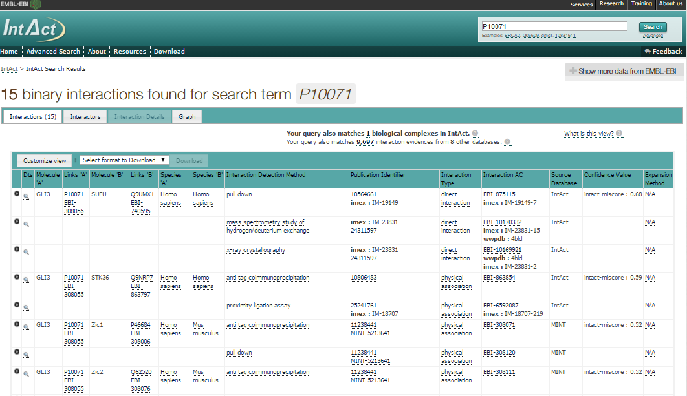
IntAct webpage-based search
Details of interaction
Link to external resource
(UniProtKB)
Details about controlled vocabulary term describing interaction detection method

Slide 10
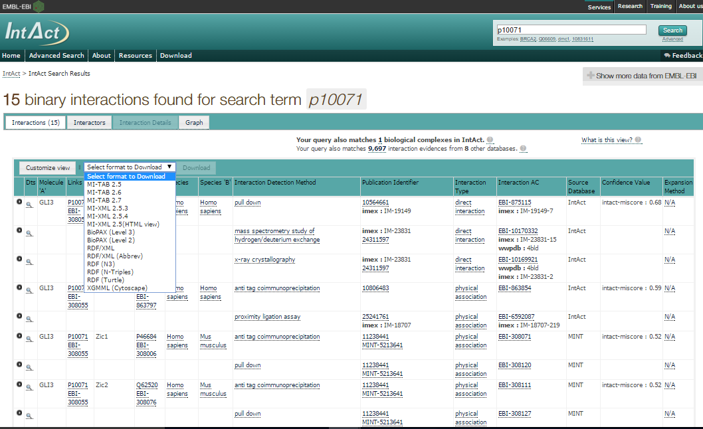
IntAct: download formats

Slide 11
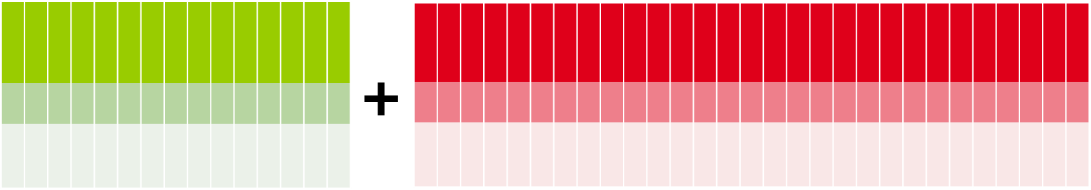
PSIMITAB Columns
MITAB 2.5 Standard columns (15):
MITAB 2.7 specific columns (+27):
Expansion method(s)
Biological role(s) of interactors
Experimental role(s) of interactors
Type(s) of interactors
Properties (CrossReference) of interactors / interaction
Annotation(s) of interactors / interaction
HostOrganism(s)
Parameters of interaction
Creation and update dates
Checksum(s) of interactors / interaction
Negative
Feature(s) interactors
Stoichiometry(s) interactors
Participant(s) identification method(s)
ID(s) interactor A & B
Alt. ID(s) interactor A & B
Alias(es) interactor A & B
Interaction detection method(s)
Publication 1st author(s)
Publication Identifier(s)
Taxid interactor A & B
Interaction type(s)
Source database(s)
Interaction identifier(s)
Confidence value(s)

Slide 12
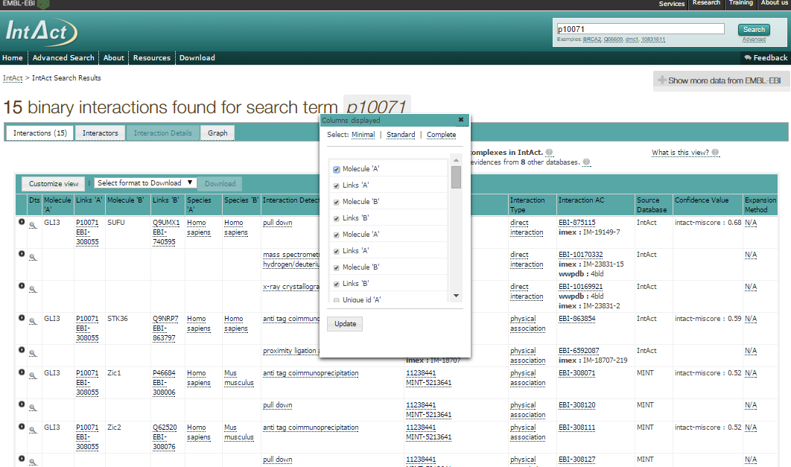
IntAct: changing the layout

Slide 13
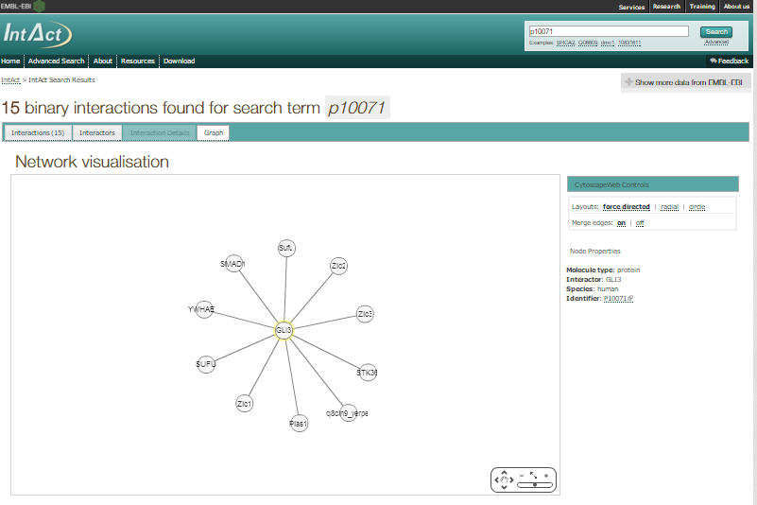
IntAct: visualizing results as a network

Slide 14
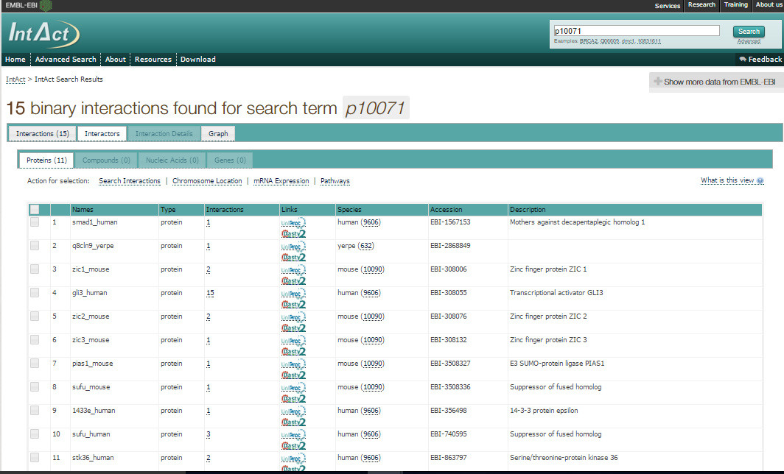
IntAct: list of interactors

Slide 15
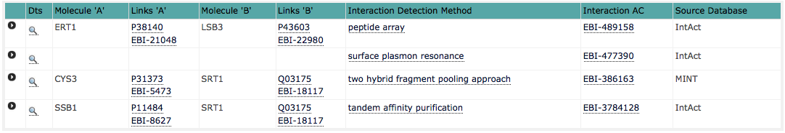
Interaction detail in IntAct

Slide 16
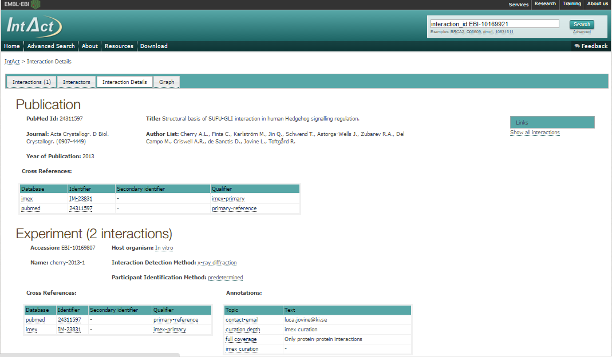
Interaction detail in IntAct

Slide 17
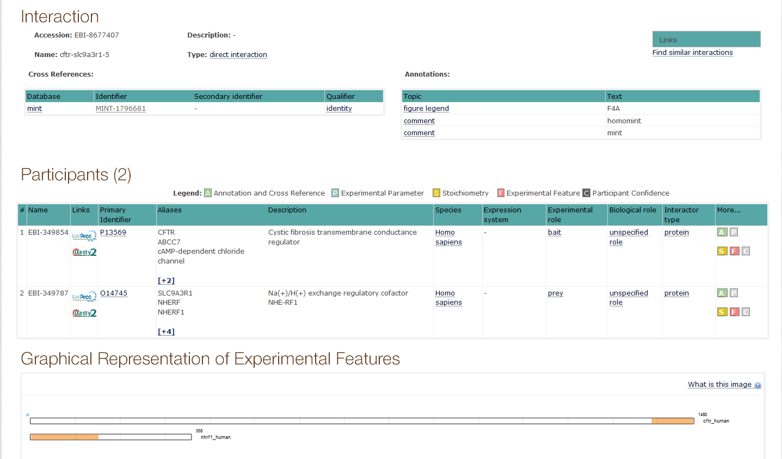
Interaction detail in IntAct

Slide 18
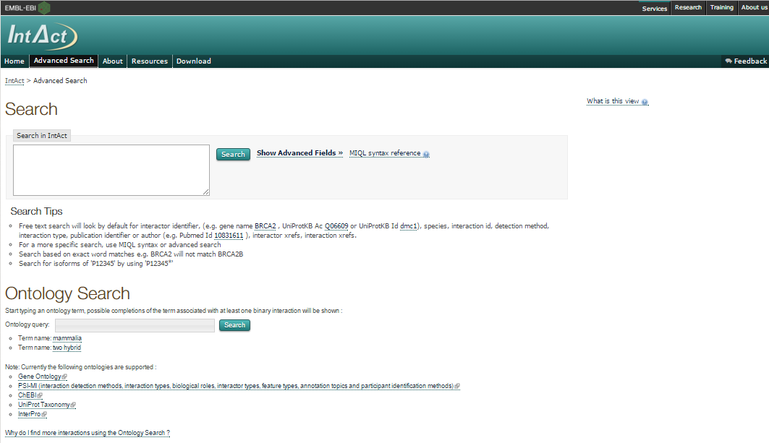
IntAct: Other searches

Slide 19
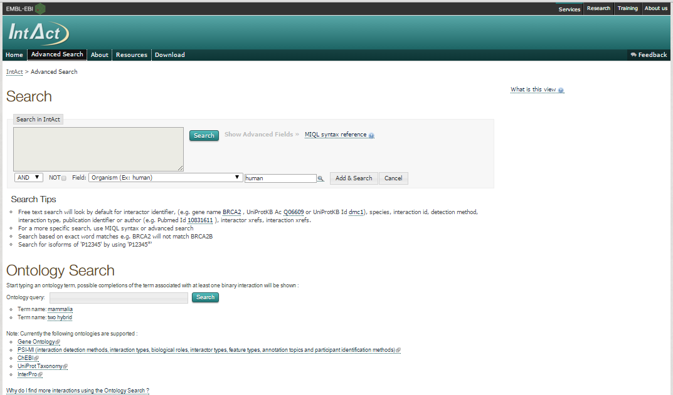
IntAct: Advanced search

Slide 20
IntAct: MIQL syntax search

Slide 21
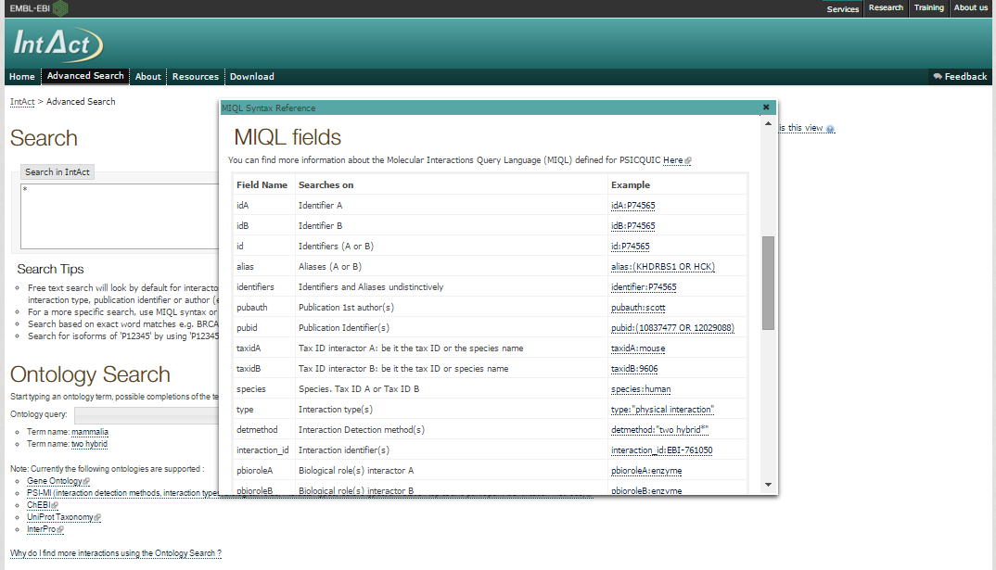
IntAct: MIQL syntax search

Slide 22
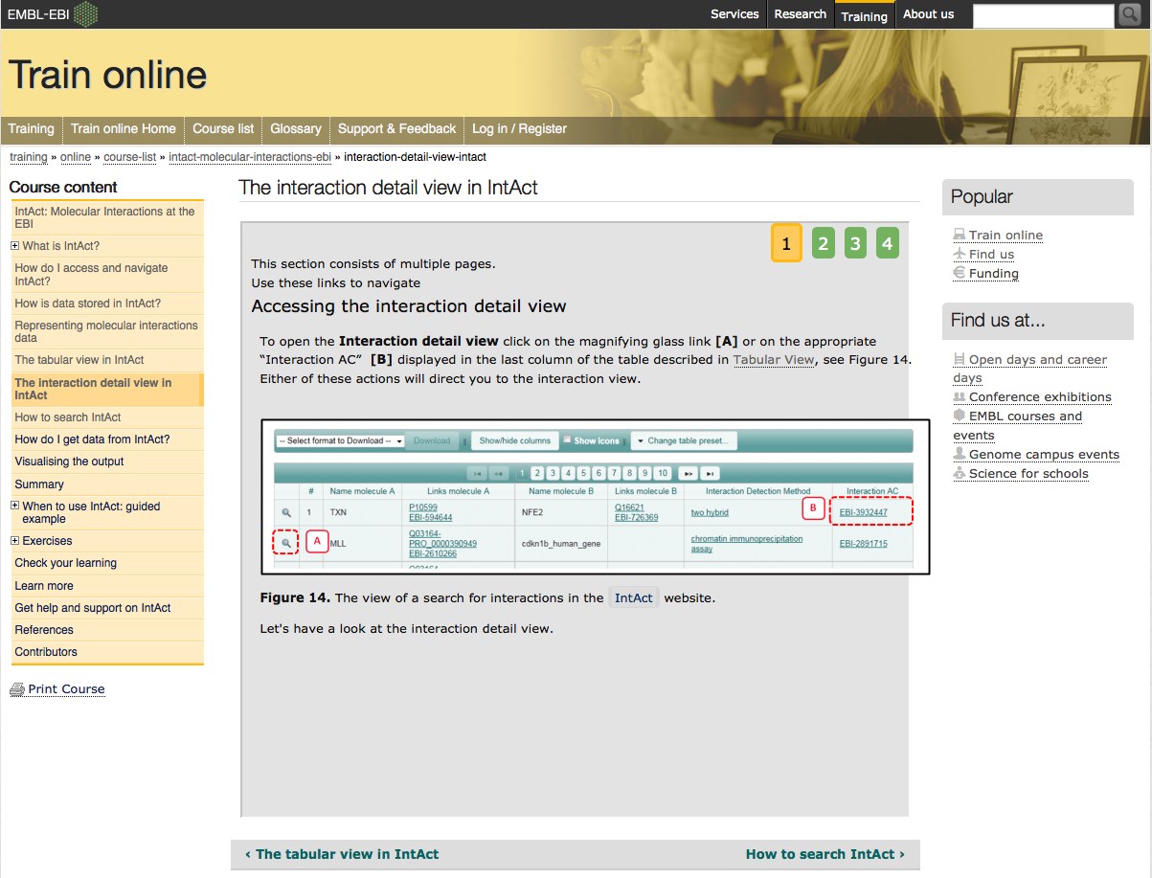
More about IntAct: on-line EBI courses
www.ebi.ac.uk/training/online/course/intact-molecular-interactions-ebi

